Slide 1
Customer Churn in Telecom
Akshda Shandilya, Bashaer Alkhattabi, Jay Patel

Slide 2
Problem Definition
The major problem is predicting whether a specific consumer would churn or not
Predicting could be obtained using a machine-learning model
Data can identify the pain points and come up with solutions that satisfy customers

Slide 3
Methodology - Data Collection
Using Pre-existing databases
Kaggel
Github
IBM Watson Customer Churn dataset
Using API
Using Web Crawling

Slide 4
Methodology - Variable Description
Variable | Data Type
Customer ID | Numeric
Age | Numeric
Gender | Categorical
Income | Numeric
Number of Calls made | Numeric
Number of text messages sent | Numeric
Churn label | Binary

Slide 5
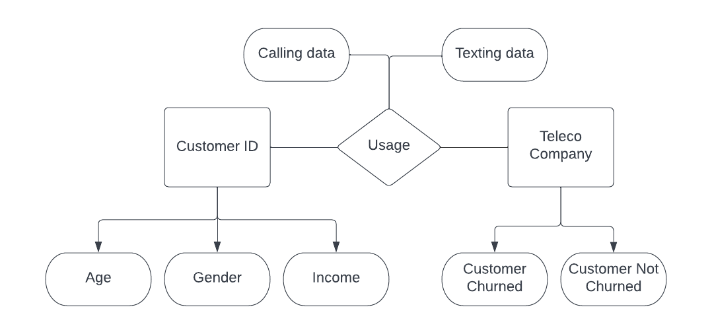
Methodology - Designing a Database

Slide 6
Methodology - Demo Data Selection - MySQL
Step 1 - Create the database for the project
Step 2 - Create a table to store the information
Step 3 - Add data to the table
Step 4 - Finding and deleting null values

Slide 7
Methodology - Demo Data Processing - Python
Step 1 - Importing the data to Jupyter Notebook
Step 2 - Splitting data for analysis
Step 3 - Displaying data using visualization tools
Step 4 - Running data through analysis -
Logistic regression model
Step 5 - Get the best repediction model

Slide 8
Methodology - Data Storage
The data will be stored on a relational database setup.
The data is organized
it is easier to run analyses on relational database
The data is not stored in a NoSQL database because:
It is more suited for a larger volume of unorganized data
It is not ideal to run analysis

Slide 9
Methodology - Potential Data Issues
Missing Information
Incorrect/missing entries can adversely impact the prediction model
Incorrect entries
If the customer information is incomplete, it may impact the prediction model
Security
It is important to secure and preserve a customer’s private information
Safety
Protection and safety of the data collected is essential

Slide 10
Results
Predicting customer churn is important to identify and keep valuable customers.
To address the problem, it would be necessary to gather data of customers and their interactions.
After the data has been collected, experts could use machine learning methods to create a model that predicts the probability of a customer leaving.
To determine the efficiency of the model, the various evaluation could be use.

Slide 11
Conclusion
Predicting customer churn is a critical business problem
Data scientists can help make such predictions and help companies retain customers
Using the predictive model from this research can help in preventing the most common data problems presented and provide the company with an accurate user information
This will also help in addressing data issues previously mentioned and accurately predict and help in prevention of churn.

Slide 12
Thank you

Slide 13
References
Amin, A., Al-Obeidat, F., Shah, B., Adnan, A., Loo, J., & Anwar, S. (2019). Customer churn prediction in telecommunication industry using data certainty. Journal of Business Research, 94, 290–301. https://doi.org/10.1016/j.jbusres.2018.03.003
Kohli, C., & Suri, R. F. (2018). Customer centricity: A review and future directions. Journal of Business Research, 84, 1-10. https://doi.org/10.1016/j.jbusres.2018.03.003

